Slide 1
The Scope
Wireless Security Lab
Attacker and Defender Nodes
Send wireless signals from Defender node to server
Website to control VMware ESXi server
OpenBTS (Base Transceiver Station)
Implement using USRP
Universal Software Radio Peripheral
LabVIEW / GNURadio
Phone Call, SMS

Slide 2
Wireless Lab Topography

Slide 3
Hardware Architecture Diagram

Slide 4
Software Architecture Diagram

Slide 5
Current Design
Software
ESXi
Operating Systems
Website
Hardware
LabVIEW
GNURadio
Asterisk
Requirements Engineering

Slide 6
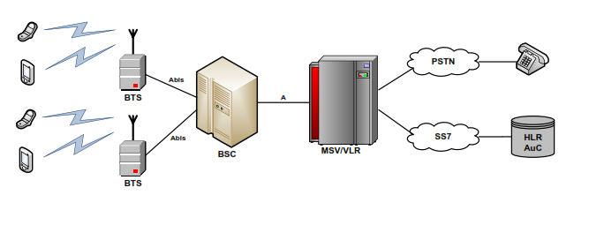
OpenBTS System Overview
MSC/VLR
Notes:
Open BTS Architecture
Open BTS software architecture is an emulation of GSM 04.03. In uplink direction, data arriving from handsets to USRP is processed with Analog to Digital
Converter (ADC). Data is then packaged with TCP/IP headers with time stamp and transferred to the host CPU using Gigabit Ethernet interface. Open BTS
transceiver synchronizes the USRP with the GSM master clock and demodulates symbol vectors for each radio. TDM layer of the GSM stack demultiplexes each burst and passes on to FEC processor. Data Link Layer (L2) then accepts the corrected data and runs link layer, segmentation and retransmission (LAPDm) processor. Signaling and Connection Management of L3 determines the message protocol and calls the appropriate control function to deserialize the message and act on its content. These control-functions also communicate with the outside world via SIP and
other protocols.

Slide 7
OpenBTS Implementation
USRP
Receive/Transmit GSM signals
Asterisk
Server
GNURadio
Open-source software development toolkit
LabVIEW
View signal output

Slide 8
Technical Challenges
LabVIEW
Operating system compatibility
Security
Outdated environment
Exploring new technologies
LAMP, ESX Shell, ESX API’s

Slide 9
Testing Plan {Hardware}
USRP Testing
Signal output verification
Spectrum sweeping
Functional Verification Testing
LabVIEW
View capture signals.
OpenBTS
Assign a phone number to each registered handset.
Allow a phone to call another one.
Allow a phone to send SMS message to another one.

Slide 10
Testing Plan {Software}
Front-end Website Testing
Functional User Testing
Back-end Modules
ESX Shell, ESX API’s
Login System
Class Creation
System Infrastructure Testing
System Integration Testing

Slide 11
Website
Webserver Location:
http://129.186.215.201
Our Website:
http://seniord.ece.iastate.edu/dec1314/
George Amariucai’s Website:
http://home.eng.iastate.edu/~gamari/
CprE 537 Website:
http://home.eng.iastate.edu/~gamari/CprE537_S12/index.html

Slide 12
Questions?

Slide 13
Wireless Lab Implementation
VMware
Backend Support
Kali Linux
Attack Clients
Ubuntu Client
Data Transmission Client
Webserver
Interface to Launch Clients

Slide 14
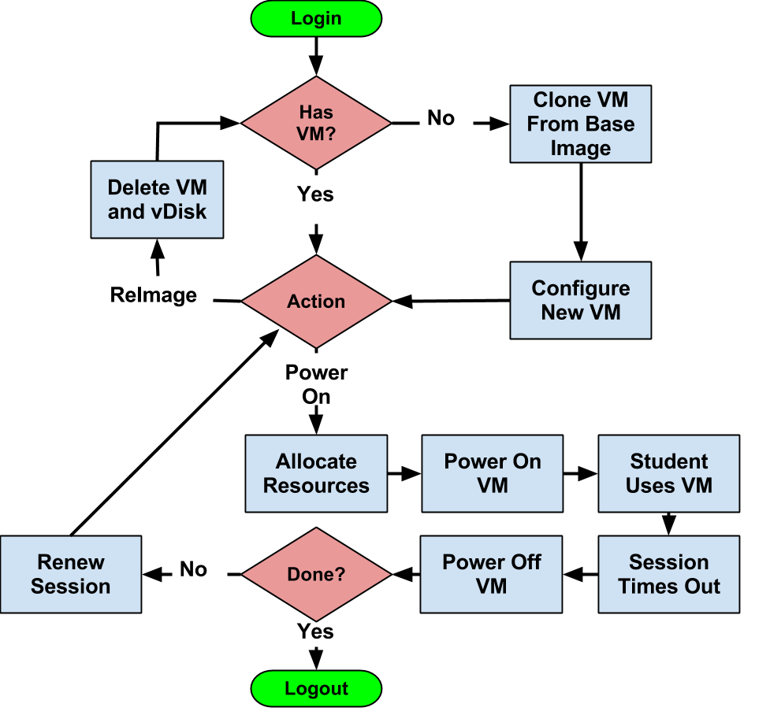
Virtualization Flowchart

Slide 15
The GSM Network

Slide 16
What is OpenBTS?
A software-based GSM access point.
It uses open-source UNIX application to present a GSM air interface to standard GSM handset devices.
In other word OpenBTS = GSM + VoIP

